Slide 1
New AP CS A Labs
Magpie, PictureLab,
and Elevens
© A+ Computer Science - www.apluscompsci.com

Slide 2
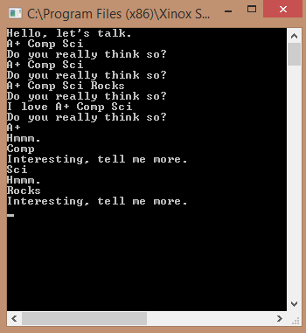
Magpie
© A+ Computer Science - www.apluscompsci.com
Notes:
Add stuff here

Slide 3
What is Magpie?
Magpie is a lab that focuses on classes, randomness, and Strings.
This lab will make sure that you know how to use the String methods substring and indexOf.
Both substring and indexOf have multiple forms as these methods have been overloaded.
© A+ Computer Science - www.apluscompsci.com
Notes:
Add stuff here

Slide 4
What is a String?
String s = "compsci";
0 1 2 3 4 5 6
s
c | o | m | p | s | c | i
A string is a group of characters.
The first character in the group is at spot 0.
© A+ Computer Science - www.apluscompsci.com
Notes:
A String is a group of characters. Strings are used to store words, which can consist of letters, numbers, and symbols.

Slide 5
String Methods from AP CS Subset
Name | Use
int length() | Returns length of String
int indexOf(String str) | Returns first position of str in the string if found, -1 if not found
String substring(int from) | Returns a substring of the string starting at from to length() – 1
String substring(int from, int to) | Returns a substring of the string starting at from to to – 1
© A+ Computer Science - www.apluscompsci.com
Notes:
Add stuff here

Slide 6

substring()
String s = "compsci";
String sub ="";
sub = s.substring(2);
out.println(sub);
sub = s.substring(2,5);
out.println(sub);
sub = s.substring(4,6);
out.println(sub);
OUTPUT
mpsci
mps
sc
0 1 2 3 4 5 6
s
c | o | m | p | s | c | i
© A+ Computer Science - www.apluscompsci.com
Notes:
The String substring() method returns a String containing a section from the original String.

Slide 7

indexOf()
String s = "compsci";
int index = s.indexOf("mp");
out.println(index);
index = s.indexOf("c");
out.println(index);
index = s.indexOf("x");
out.println(index);
OUTPUT
2
0
-1
0 1 2 3 4 5 6
s
c | o | m | p | s | c | i
© A+ Computer Science - www.apluscompsci.com
Notes:
The String indexOf() method looks for a value and returns the spot at which that value is stored. If the value provided is not present in the String, -1 is returned. -1 would not be a valid spot in the String which is why -1 was chosen as the return value when a value is not found.

Slide 8
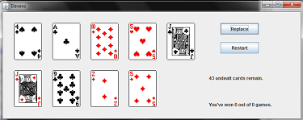
Elevens
© A+ Computer Science - www.apluscompsci.com
Notes:
Add stuff here

Slide 9
What is Elevens?
Elevens is a lab about classes and Lists.
List< SomeClass> is a major concept being tested by the Elevens lab.
Elevens is a multi-class project that uses a Card and Deck class to simulate the playing of cards.
© A+ Computer Science - www.apluscompsci.com
Notes:
Add stuff here

Slide 10
Lists
OUTPUT
h
c
List<String> ray;
ray = new ArrayList<String>();
ray.add("hello");
ray.add("whoot");
ray.add("contests");
out.println(ray.get(0).substring(0, 1));
out.println(ray.get(2).substring(0 ,1));
ray stores String references.
© A+ Computer Science - www.apluscompsci.com
Notes:
In the example above, ray is an ArrayList that stores String references.

Slide 11
public class Dog
{
private int age;
private String name;
public Dog( String n, int a ) {
age = a;
name = n;
}
public int getAge() {
return age;
}
public String getName() {
return name;
}
public String toString() {
return "Dog - " + name + " " + age;
}
}
Basic
Dog_x000b_Class
© A+ Computer Science - www.apluscompsci.com
Notes:
Classes are used to store related methods and variables.

Slide 12
List of References
List<Dog> ray;
ray = new ArrayList<Dog>();
ray.add( new Dog( "fred", 11) );
ray.add( new Dog( "ann", 21) );
System.out.println( ray );
OUTPUT
[Dog - fred 11, Dog - ann 21]
© A+ Computer Science - www.apluscompsci.com
Notes:
Lists / ArrayLists can store references to objects. This enables each spot in the List / ArrayList to house more than just a single value. Each spot can house multiple variables and methods all of which would be contained in a class.

Slide 13
List of References
List<Creature> creatures;
creatures = new ArrayList<Creature>();
creatures.add(new Creature(4));
creatures.add(new Creature(9));
creatures.add(new Creature(1));
0 1 2
creatures
0x12 | 0x32 | 0xD2
Creature
4
Creature
9
Creature
1
© A+ Computer Science - www.apluscompsci.com

Slide 14
ArrayList frequently used methods
Name | Use
add(item) | adds item to the end of the list
add(spot,item) | adds item at spot – shifts items up->
set(spot,item) | put item at spot z[spot]=item
get(spot) | returns the item at spot return z[spot]
size() | returns the # of items in the list
remove() | removes an item from the list
clear() | removes all items from the list
import java.util.ArrayList;
© A+ Computer Science - www.apluscompsci.com

Slide 15
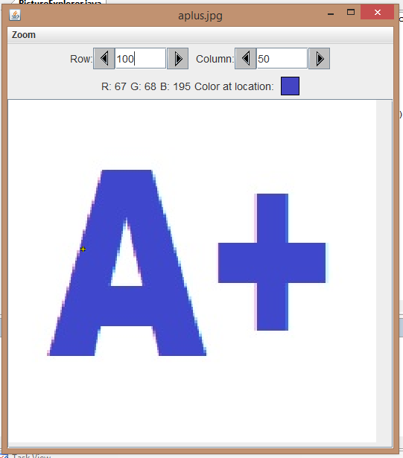
Picture Lab
© A+ Computer Science - www.apluscompsci.com

Slide 16
What is Picture Lab?
PictureLab is a lab that focuses on matrices.
Matrices are arrays of arrays. The PictureLab will focus heavily on this concept.
Matrices can store references. PictureLab will use a matrix of references.
Searching matrices is also tested.
© A+ Computer Science - www.apluscompsci.com
Notes:
Add stuff here

Slide 17
What is a matrix?
A matrix is an array of arrays.
int[][] mat = new int[3][3];
mat[0][1]=2;
0 1 2
0
1
2
0 | 2 | 0
Which
array?
0 | 0 | 0
Which
spot?
0 | 0 | 0
© A+ Computer Science - www.apluscompsci.com
Notes:
Each spot in an matrix stores the location/address of an array.
mat[0] stores the location / address of a one-dimensional array.
mat[0][1]=2;
This line sets mat[0] spot 1 to 2.

Slide 18
public class Dog
{
private int age;
private String name;
public Dog( String n, int a ) {
age = a;
name = n;
}
public int getAge() {
return age;
}
public String getName() {
return name;
}
public String toString() {
return "Dog - " + name + " " + age;
}
}
Basic
Dog_x000b_Class
© A+ Computer Science - www.apluscompsci.com
Notes:
Classes are used to store related methods and variables.

Slide 19
Matrix of References
OUTPUT
null
fred 11
Dog[][] herd;
herd = new Dog[3][3];
herd[0][0] = new Dog( "fred", 11) ;
herd[1][2] = new Dog( "ann", 21) ;
System.out.println( herd[2][2] );
System.out.println( herd[0][0] );
© A+ Computer Science - www.apluscompsci.com
Notes:
Matrices can store references to objects. This enables each spot in the matrices to house more than just a single value. Each spot can house multiple variables and methods all of which would be contained in a class.

Slide 20
Searching a Matrix
int[][] mat = {{5,7},{5,3,4,6},{0,8,9}};
int count = 0;
for( int[] row : mat )
{
for( int num : row )
{
if( num == 5 )
count++;
}
}
System.out.println("5 count = " + count);
OUTPUT
5 count = 2
© A+ Computer Science - www.apluscompsci.com
Notes:
Searching for values in an array or matrix is a common process often tested on the AP exam.

Slide 21
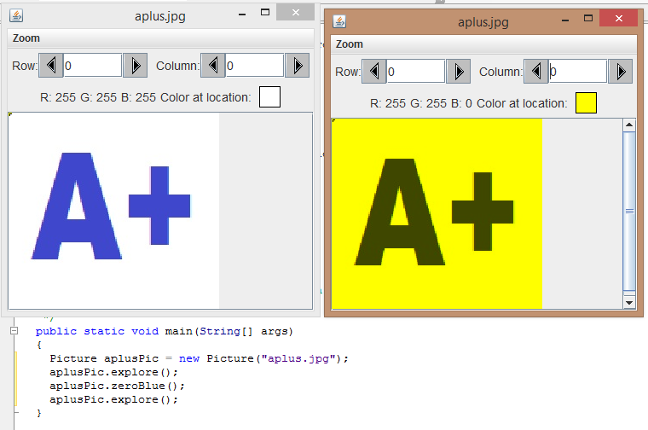
What is a Picture?
© A+ Computer Science - www.apluscompsci.com

Slide 22
Start work
on the Labs
© A+ Computer Science - www.apluscompsci.com

